Slide 1


Automatic Modulation Recognition
The project addresses the crucial challenge of accurately classifying modulation types in telemetry, tracking, and command (TTC) systems, particularly for signals with low carrier-to-noise density ratios (CNR).
This is a significant advancement, enabling real-time signal recognition and efficient data processing for reliable communication.

Slide 2
Proof of concept
Product Overview:
Target Customers
Key Advantages and Values:
Software Component: • AI/ML-Based Algorithm: Capable of accurately recognizing and classifying various modulation types to ensure high precision. Threshold-Based Logic: Utilizes predefined signal characteristics for quick decision-making to complement the hardware implementation.
Large organizations involved in data communication and signal modulation, such as ISRO, NASA, DRDO and other aerospace, defense, and telecommunications entities
• Compact and Fast: Ensures minimal footprint and rapid processing.
• High Accuracy: Leveraging the AI/ML approach for High Accuracy of >92% on SNR range [0,18]. Thresholding based approach has Accuracy of >95%.
Hardware Component: • Real-Time Processing Module: Implemented using an PYNQ-Z2 FPGA to execute the threshold-based approach for efficient, real-time signal classification.
• Scalability: Adapts to various modulation schemes.
• Hardware-Friendly: Efficient thresholding logic suitable for embedded systems.

Slide 3
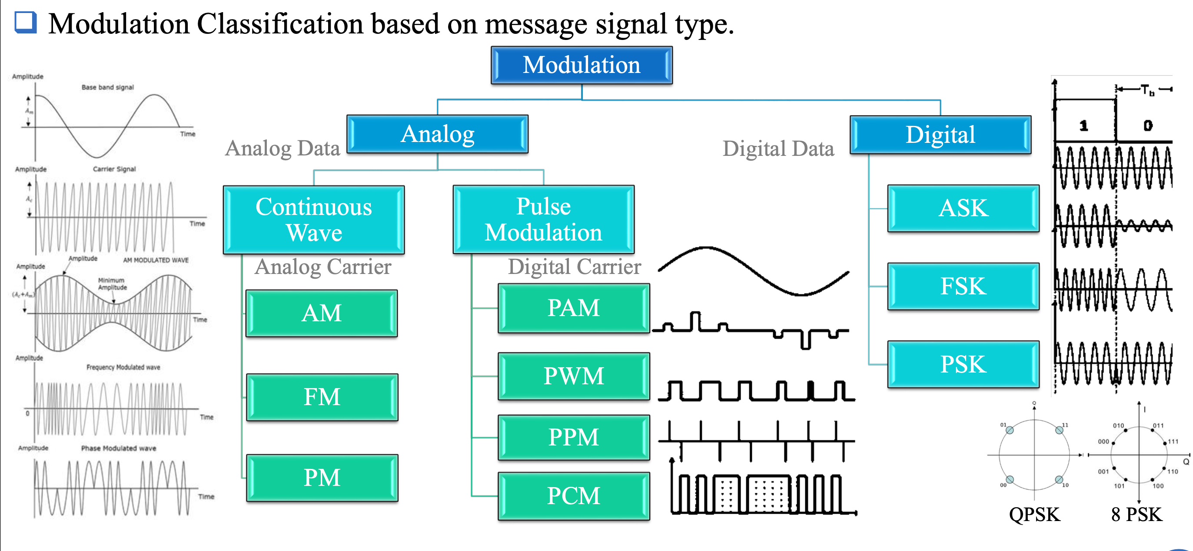

Slide 4
The Problem: Challenges in Low CNR Environments
Traditional Automatic Modulation Recognition (AMR) models struggle to effectively classify modulation types in low CNR environments. This is due to the high computational complexity of these models and their limited capabilities in identifying complex signals. This hinders the implementation of reliable real-time solutions for TTC systems, leading to potential data errors and communication disruptions.
1
Low Accuracy
2
Computational Complexity
3
Limited Identification Capabilities
The high noise levels in low CNR environments significantly degrade the signal quality, leading to misclassifications by traditional AMR models.
These models require significant computational resources, making them impractical for real-time applications in resource-constrained satellite systems.
The distortion of signals in low CNR environments often exceeds the capabilities of existing models, hindering their ability to reliably identify modulation types.

Slide 5
Efficient, Real-Time Solutions Needed
We developed a real-time solution to accurately classify modulation types in low signal-to-noise conditions, enabling reliable satellite communications. The system combines AI/ML and thresholding methods, and is implemented on an FPGA platform for efficient, low-latency processing..
1
Identifying the Problem
ISRO identified the challenges associated with modulation classification in low CNR environments and the need for a real-time solution.
2
Research and Development
The project team focused on developing optimized algorithms for modulation classification using combination of CNN and LSTM models, considering both accuracy and real-time processing requirements.
3
Implementation and Testing
The developed algorithms were validated through simulations on MATLAB and hardware implementation using FPGA, ensuring the system's efficiency and robustness.

Slide 6
The Solution: A Dual-Approach Strategy
The solution combines AI/ML and thresholding methods to accurately classify modulation types in low signal-to-noise conditions, while enabling real-time processing on an FPGA platform.
AI/ML-Based Approach
Thresholding-Based Approach
This method utilizes CNN and LSTM layers for highly accurate modulation classification. While computationally intensive, it excels in handling complex signal distortions and provides high accuracy of >92% for signals of SNR [0,18] with only around 100,000 Parameters.
This approach relies on predefined conditions and thresholds for real-time modulation classification. It is computationally efficient, suitable for hardware implementation, and provides a fast, reliable solution.

Slide 7
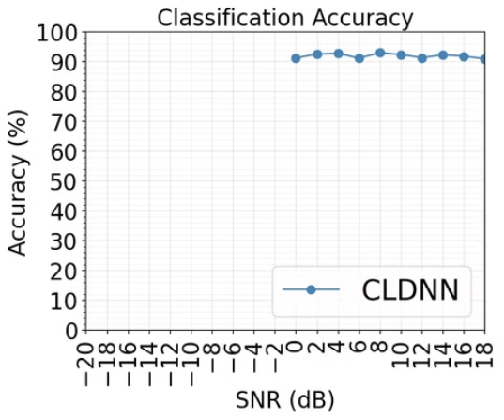
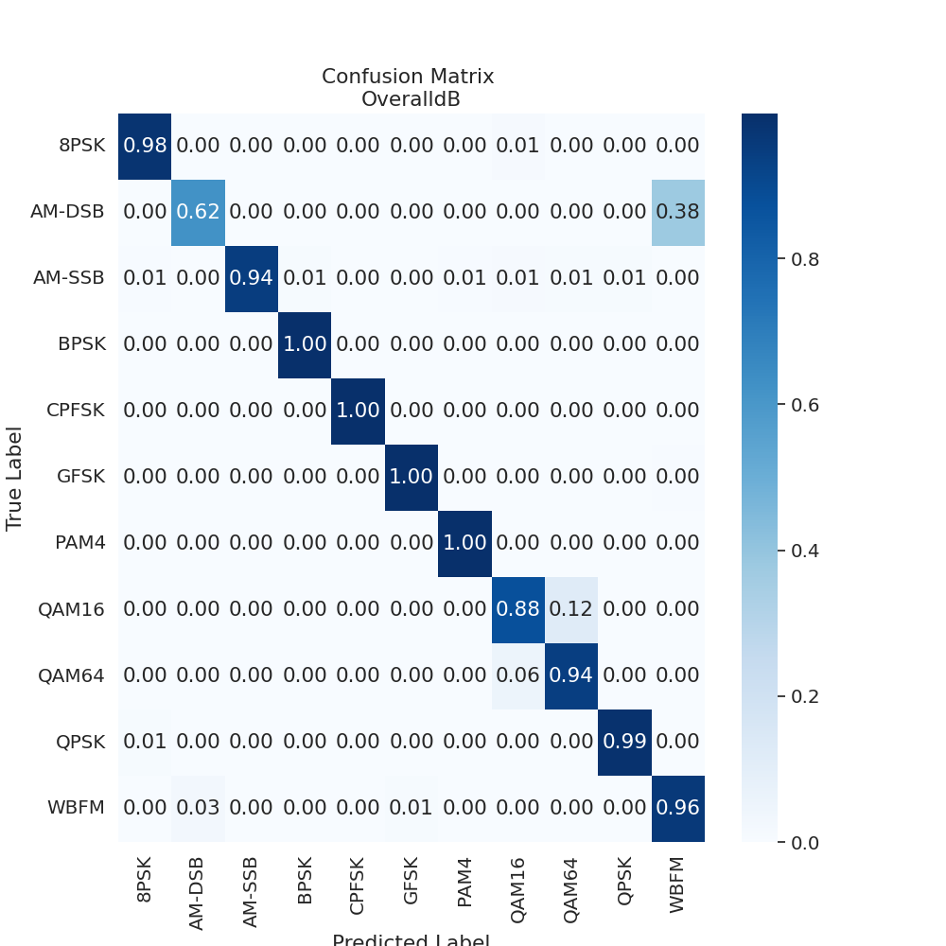
Results
We Benchmarked the ML model using Confusion Matrices, Tested on DeepSig RadioML 2016.10A Dataset
Classification Accuracy plot and Confusion Matrix for all the SNRS combined [0,18] in steps of 2

Slide 8
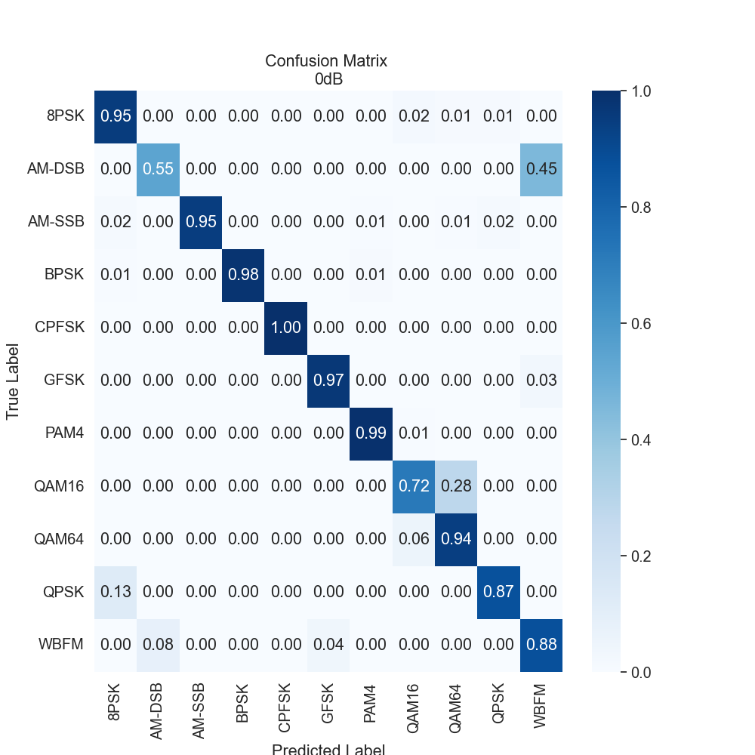
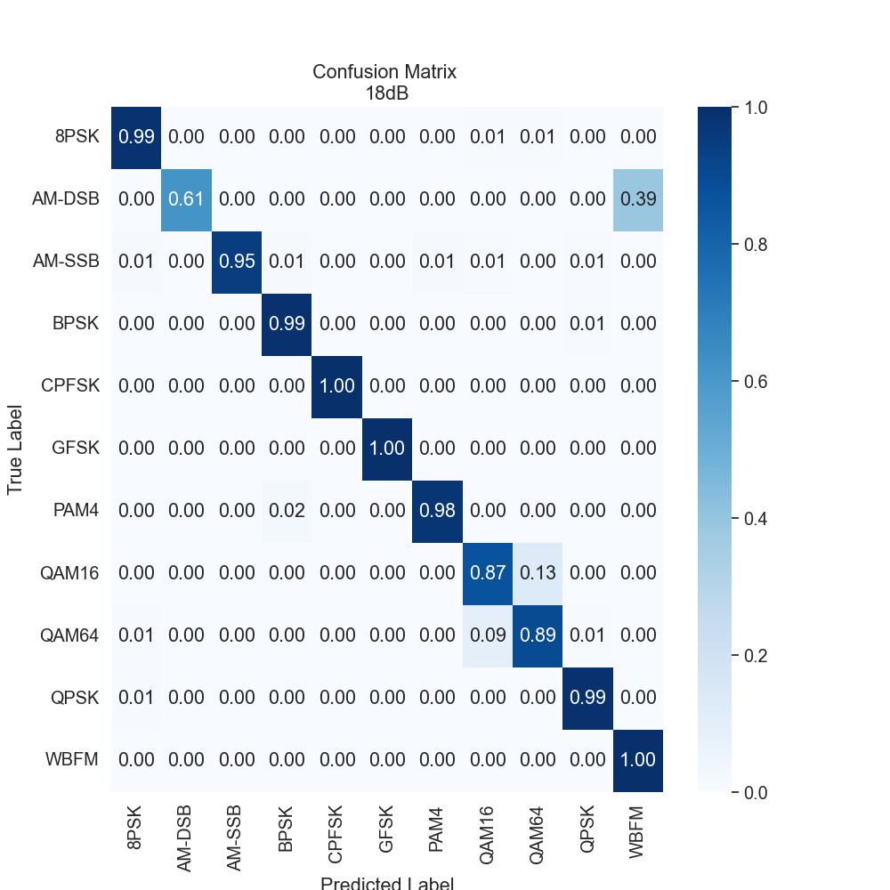
Confusion Matrix for SNR = 18 dB and 0dB

Slide 9
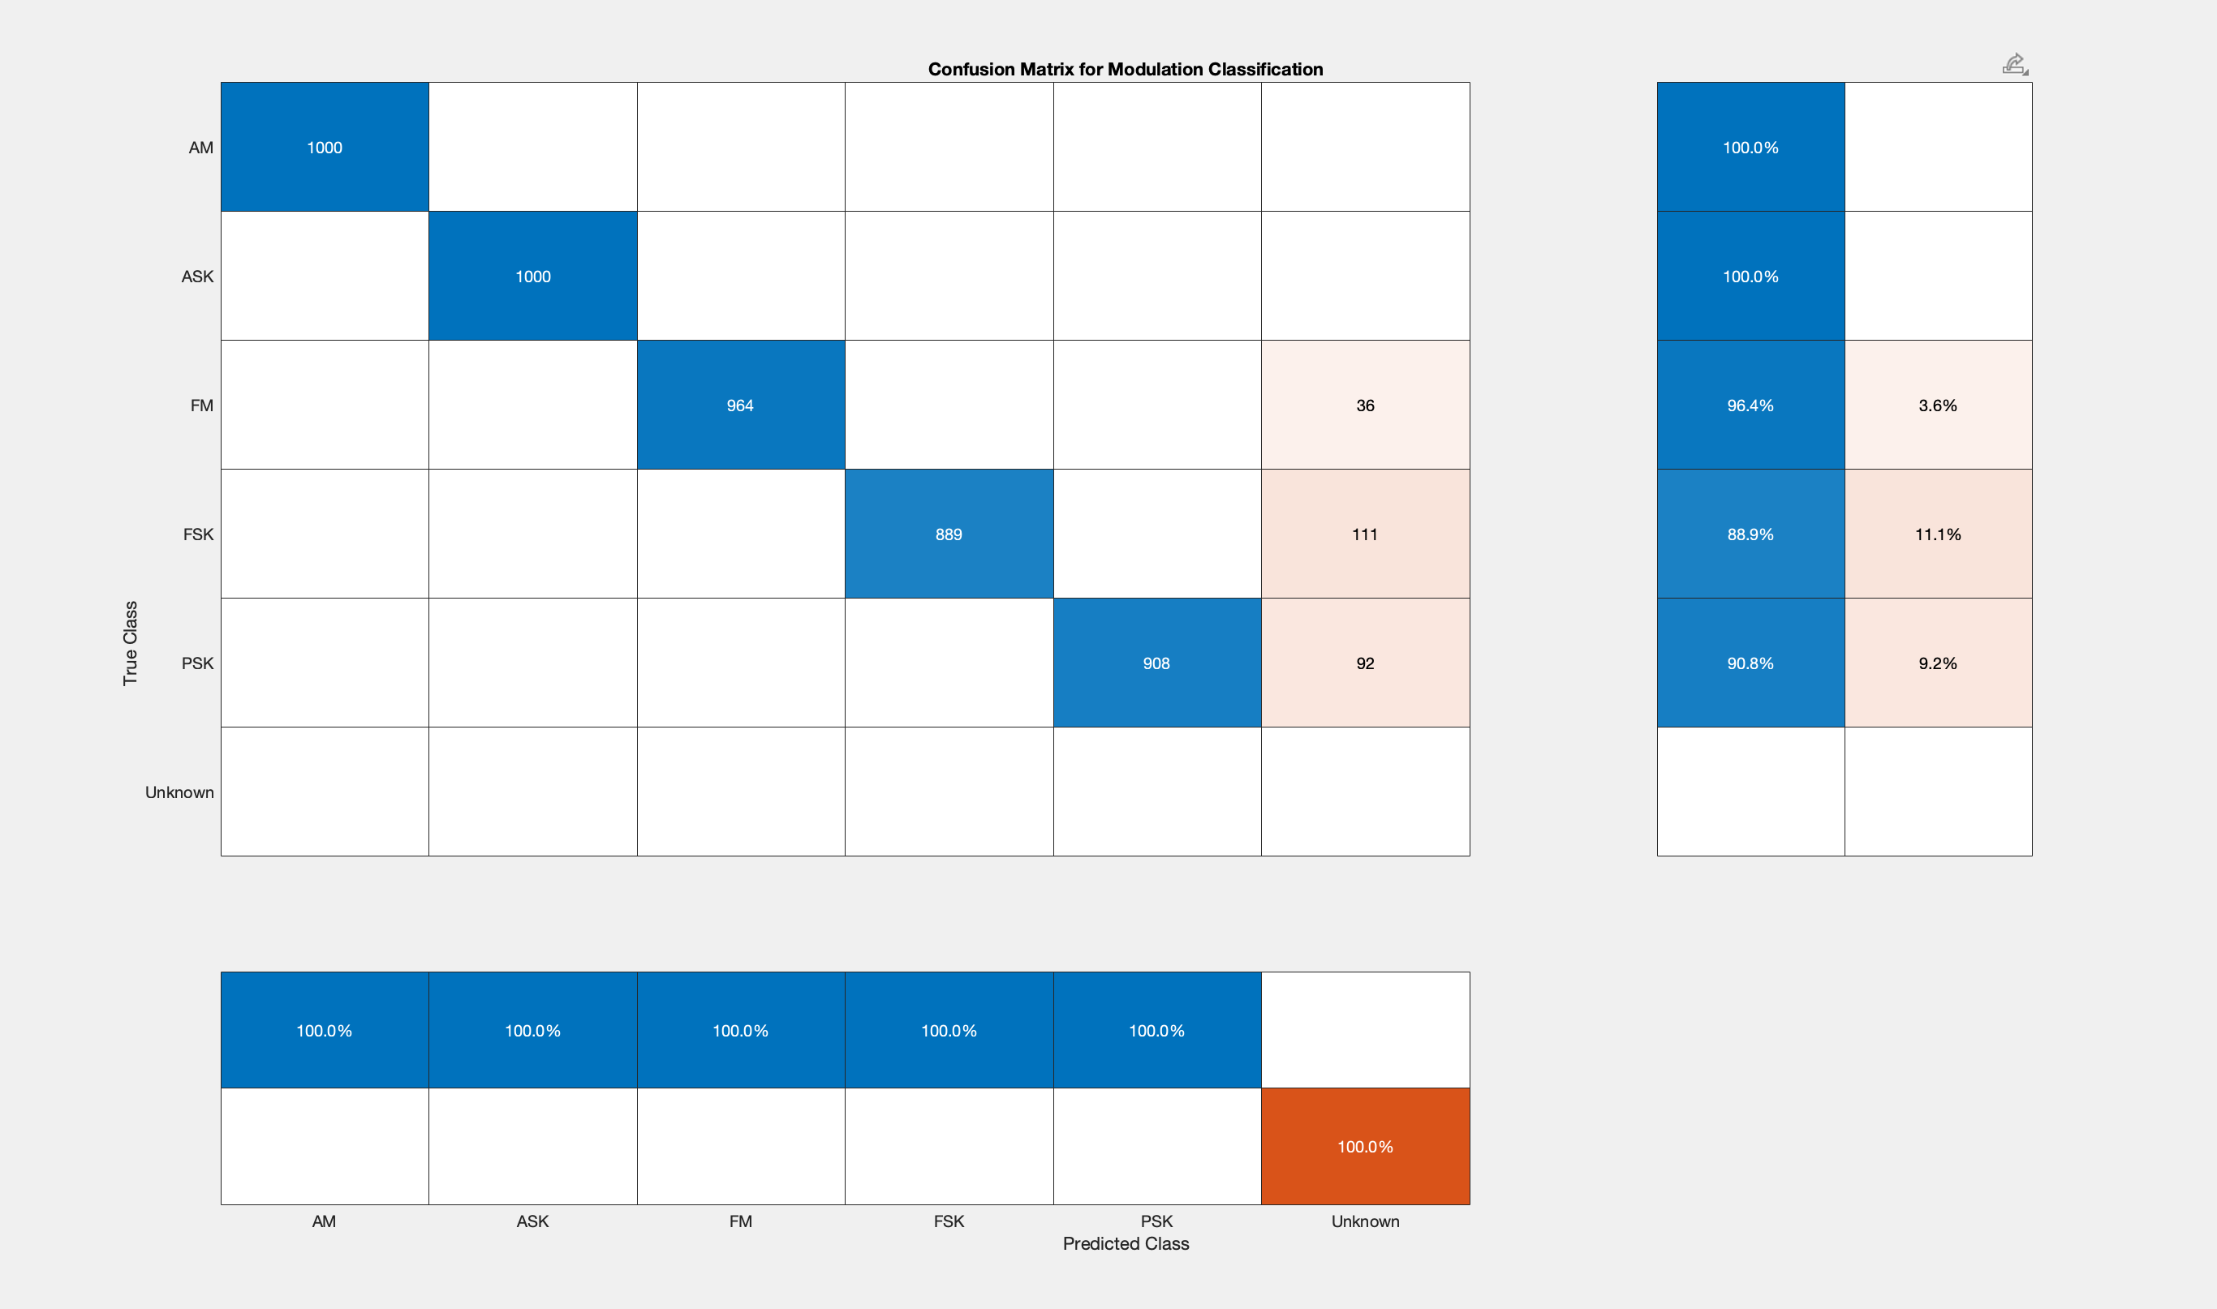
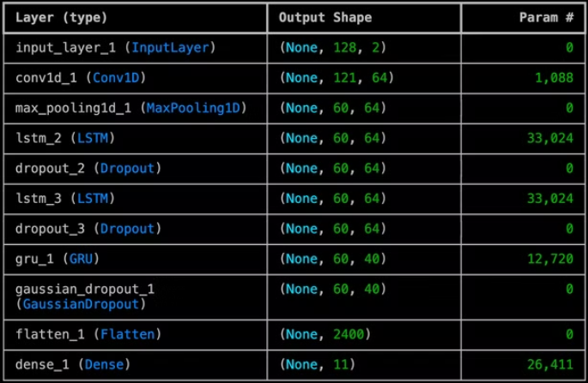
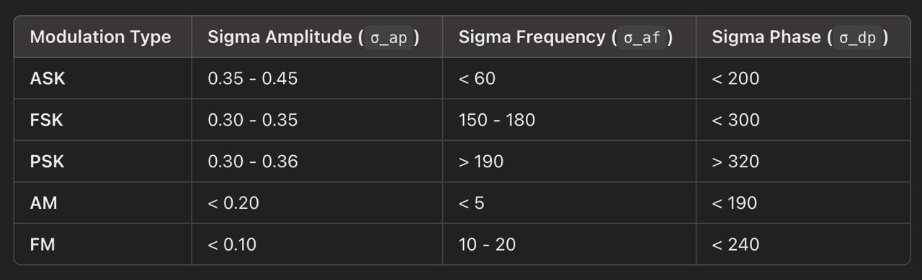
MatLab code's Confusion Matrix and ML Model Summary

Slide 10
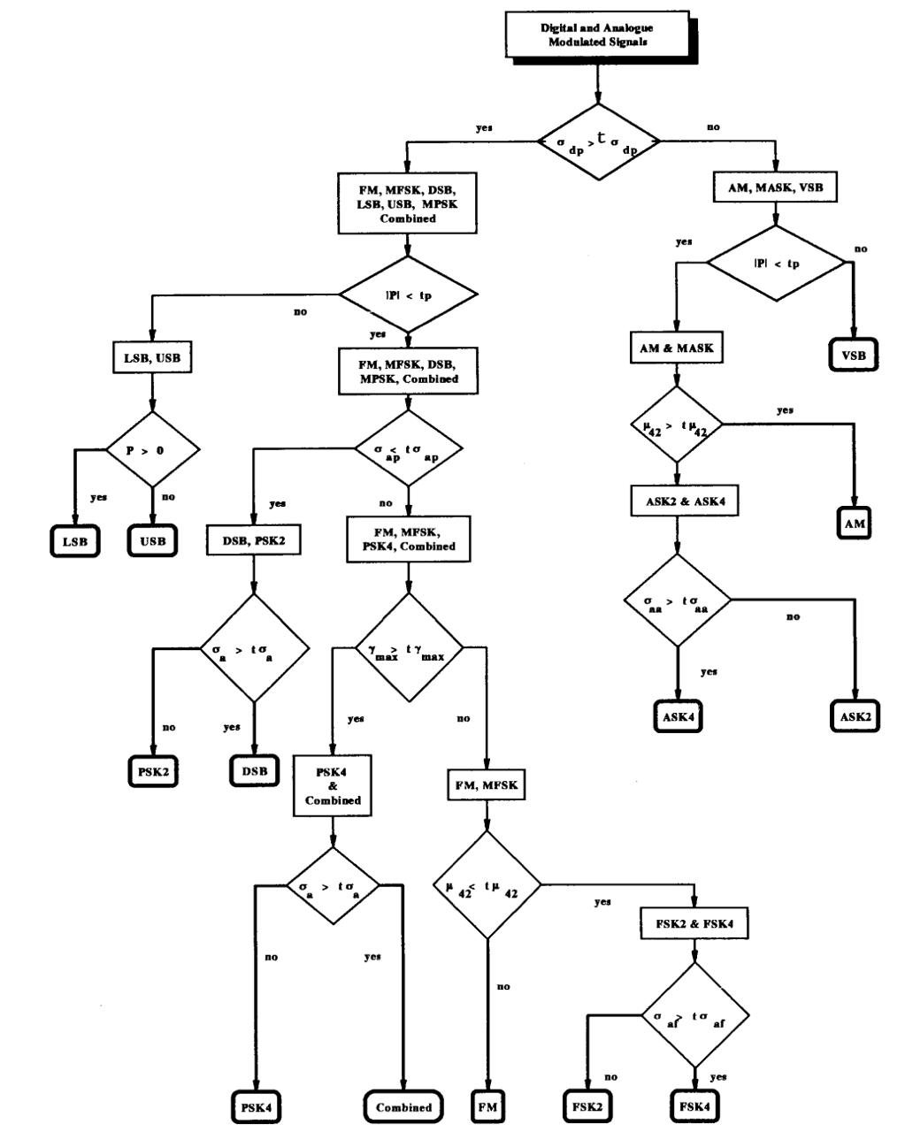
Thresholding Based Approach

Slide 11
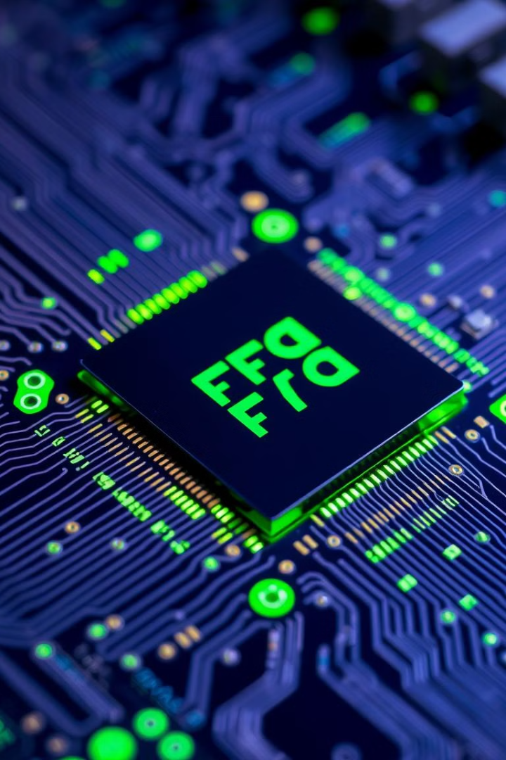
FPGA-Based Implementation: Enabling Real-Time Processing
The system uses an FPGA for real-time processing. FPGAs provide the flexibility and parallel power needed to efficiently classify modulation types.
FPGA-Based Implementation
Advantages
Parallel Processing
Enables real-time processing for high-speed applications.
Flexibility
Allows for easy reconfiguration and adaptation to changing requirements.
Low Latency
Minimizes delays in signal processing, crucial for real-time applications.

Slide 12
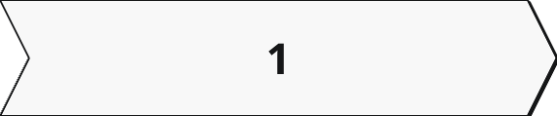
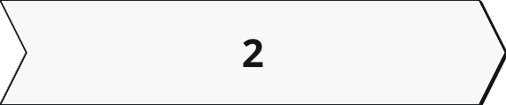
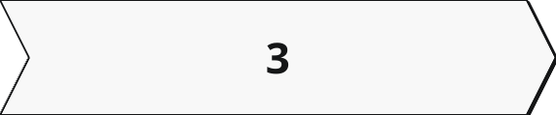
Validation and Testing: Ensuring Accuracy and Reliability
Testing the ML model on datasets
MATLAB Simulations
HDL Implementation
Extensive simulations were conducted to evaluate the accuracy of the algorithms under various CNR conditions and signal scenarios.
The algorithms were implemented using Hardware Description Language (HDL), enabling the creation of FPGA-compatible code for hardware verification.
Testing the CNN + LSTM layers based ML model on the DeepSig's 2016.10A RadioML dataset consisting of 11 modulations with SNR range of [-20,18].

Slide 13





Benefits and Impact: A Breakthrough for Satellite Communication
The developed adaptive telecommand receiver system improves satellite communication in low CNR environments. It enables real-time signal recognition, enhances data accuracy, and ensures reliable communication links. This leads to improved efficiency, reduced error rates, and enhanced data transmission capabilities..
Enhanced Data Accuracy
Real-Time Signal Recognition
Accurate modulation classification minimizes errors and improves the reliability of data transmission.
The FPGA-based implementation enables fast and efficient processing, ensuring real-time signal identification.
Improved Efficiency
Enhanced Data Transmission Capabilities
The system optimizes resource utilization and minimizes processing delays, leading to improved overall efficiency.
Reliable signal recognition enables more efficient data transmission and improved communication links.

Slide 14



•Potential Market
•Defense and Aerospace: AMR on FPGA enables fast signal classification for radar, electronic warfare, and secure communications, essential for distinguishing between friendly and adversarial signals.
•Telecommunications: Supports efficient spectrum use, interference mitigation, and dynamic spectrum access in expanding 5G/6G networks.
•IoT and Connected Devices: Enhances communication reliability and interference detection in IoT networks, optimizing performance in smart cities and industrial applications.
•Automotive and Autonomous Systems: Facilitates robust, adaptive communication in dynamic environments, supporting safer operations for autonomous vehicles and drones.

Slide 15

Potential growth, increase in requirement and investor
Defense: Increasing defense budgets focus on electronic warfare and signal intelligence, driving demand for fast, reliable FPGA-based AMR systems for secure communication and threat identification (7% CAGR in military FPGA solutions) .Ex- DRDO.
5G and 6G Networks: As 5G expands and 6G emerges, efficient spectrum management is crucial. FPGA-based AMR supports spectrum sensing and interference detection, aligning with the 5G infrastructure market growth (30% CAGR until 2025). Ex- Jio, Airtel
IoT and Edge Computing: The $1 trillion IoT market by 2030 needs robust signal processing for dense networks. FPGA-based AMR suits edge devices, offering real-time modulation classification without compromising speed.
Automotive and Autonomous Systems: Autonomous vehicles and drones require reliable, low-latency communication. FPGA-based AMR facilitates adaptive modulation recognition, matching the autonomous vehicle market growth (20% CAGR).

Slide 16
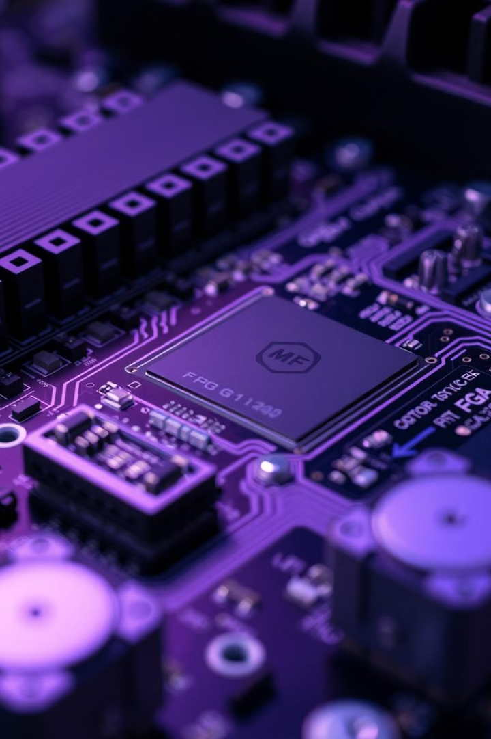
Novelty & IP strategy
Differentiation Points:
1.High Accuracy Algorithm: Deployed a ML model that classifies the modulated signal with accuracy of >92% for 11 types modulated signals of Sound to Noise Ratio (SNR) of [0,18].
2.Power Efficiency Architecture: The power efficiency of the Hardware - PYNQ-Z2 FPGA is excellent, running smoothly on just 5 volts.
3.Modular Scalability: FPGA-based scalability enabling seamless integration into diverse communication systems.
4.Existing Patents: Current patents focus on FPGA-based AMR for stable, high-throughput processing in environments like electronic warfare and telecom, using fixed thresholds and blind equalization​Justia Patents , Eurasip

Slide 17
Value Proposition
High Speed & Low Latency:
Power Efficiency:
High Accuracy Model:
Scalability and Flexibility:
Uses 40% less power, ideal for IoT and autonomous applications
Achieves >92% accuracy across modulation schemes, 10-15% higher than traditional models.
Processes signals with <100ms latency with our Thresholding approach.
Reconfigures in <10 ms, 30% faster than competitors, adaptable to evolving protocols.
108k params ML model for classifying signals

Slide 18
Competitive Landscape
Limited Competition
1
The automatic modulation recognition (AMR) market is currently dominated by Keysight Technologies.
Early Stage
2
This presents a unique opportunity for us to establish ourselves as a key player in the market.
Focus on Differentiation
3
Our technology offers a compelling alternative to traditional methods, with our FPGA-based approach.

Slide 19


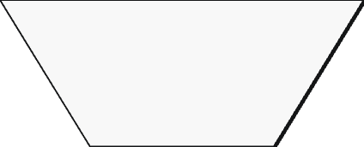

Current Status
Product Completion
1
50% complete
Implementation
2
AIML model onto FPGA or Nvidia Jetson nano
I/O Device Interfacing
3
Have to integrate the input device to the FPGA
4
CNN Challenges
Implementation on FPGA

Slide 20
Milestones
1
Integrating I/O Interface
Firstly, we have to integrate a interface so that we can give directly input to the FPGA and display the result on the LCD display or any other output device. Required Time - 6 months
Targets - We will integrate an input and an output device. Possible input device might be – Transponders and Receiving Antennas.
2
Implementation of AIML model directly onto the FPGA
Implementation of the ML algorithm onto the FPGA. This involves porting the model to a hardware-compatible format and optimizing its performance.
Required Time - 12 months
Targets - We require experienced people with knowledge about FPGA and its hardware. We will hire them and determine a solution. We are currently exploring a option of compiling the whole ML model into a Bitstream. We also have a possible solution of deploying the ML model onto a Nvidia Jetson nano kit and bundle it together with the FPGA.
3
Testing and Benchmarking
Integration and testing of the I/O device and the deployed ML model. This stage focuses on ensuring seamless operation of the FPGA on the consumer end. Required Time - 3 months
4
Product Finishing
This stage involves packaging the whole project into a single deliverable item and improving its design aesthetics.

Slide 21
Project Team Details
Desired Profile
Identified Candidates
We seek team members with expertise in Electronics and experience with FPGAs.
We are currently exploring potential candidates from various networks and online platforms.
A background in electrical engineering is ideal.
We have currently identified some M.Tech and PhD students qualified to work on this project.
Also someone with business background to run the business end of operations.
Business Orientation
We intend to recruit a team member with strong business acumen and experience in the electronics and communication sector.

Slide 22


Project Mentors
Dr. Robin Khosla
Nikhil Chauhan
Project Faculty Mentor
Project Mentor

Slide 23



Project Team members
Saurabh Singh -Project leader
Bharat Agrawal – Member
Yash Verma –Member
CSE
CE
MNC
Indian Institute of technology
Indian Institute of technology
Indian institute of technology
Mandi
Mandi
Mandi

Slide 24



Rudraksh Lande- Member
Karan Seth – Member
Mohit – Member
CSE
CE
CSE
Indian institute of technology
Indian Institute of technology
Indian Institute of technology
Mandi
Mandi
Mandi

Slide 25
Budget
Heads
Amount (Rs lakh)
Basis/Justification
Equipment
₹75,000
FPGA or any other device cost
Consumables
₹5,000
Connecting wires, Miscellaneous
Man power
₹ 50,000
Reimbursement for labour
Rental/others
₹20,000
Place for work
Travel
₹ 0
Outsourcing
₹75,000
For hiring skilled people
IP
₹15,000
For backup equipment
Contingency
₹20,000
For other equipment for
Future innovation / Backup
Total
₹2,50,000

Slide 26
Milestones
Target date
Milestone targets
Funds requested
(at end of __ months)
0
Signing of agreement
₹1,00,000
12
Completion of 1st Milestone (M1)
₹75,000
18
Completion of 2nd Milestone (M2)
₹50,000
24
Completion of project and submission of final report (M3)
₹25,000

Slide 27
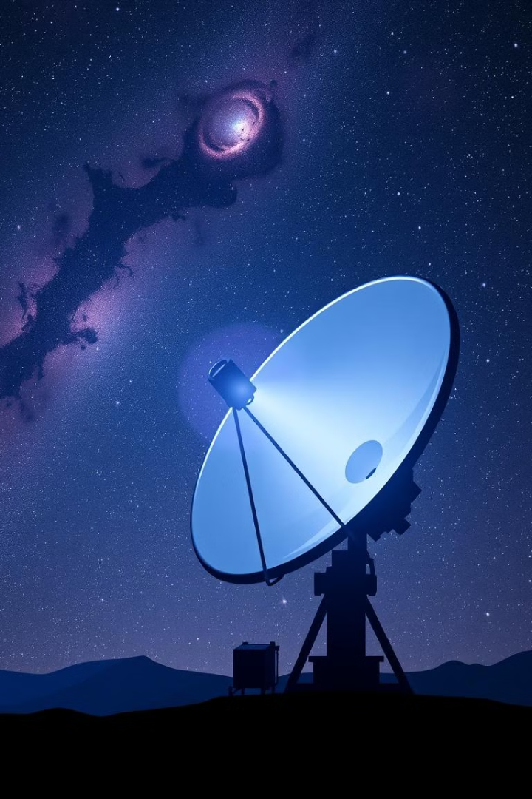
Conclusion: A Significant Advance for Communication via Signals
The development of this adaptive telecommand receiver system represents a significant advancement in satellite communication technology. It addresses a critical challenge in low CNR environments, providing a reliable and efficient solution for modulation classification. This innovation paves the way for improved data transmission, reduced error rates, and more robust satellite communication systems, ensuring the smooth operation of vital communication networks.

